Slide 1


Amazon Sales Data Analysis

Slide 2


Overview:
This presentation provides an overview of Amazon's sales data from 2010 to 2017. We will analyze various metrics such as units sold, total cost, total profit, order priorities, sales modes, and regional revenue distribution.

Slide 3

Evaluate Sales Trends Over Time: Assess and identify significant changes or patterns in sales data from 2010 to 2017.
Compare Offline and Online Sales: Determine the impact of online sales on total revenue and profit margins compared to offline sales.
Key Objectives
Analyze Units Sold, Total Cost, and Profit: Highlight and evaluate key metrics: total units sold (513K), total cost (93M), and total profit (44M).
Identify Top Performing Product Categories: Examine and focus on the top 5 profitable item types: Cosmetics, Household, Office Supplies, Clothes, and Baby Food.
Assess Regional Revenue Distribution: Evaluate revenue distribution across different regions and identify the highest and lowest revenue-generating areas.
Derive Strategic Recommendations: Summarize key insights from the data and provide actionable recommendations to inform future business strategies.

Slide 4

Data Visualization Charts:
Year-Wise Sales:
Analysis of sales from 2010 to 2017.
Highlight any notable trends or changes.

Slide 5
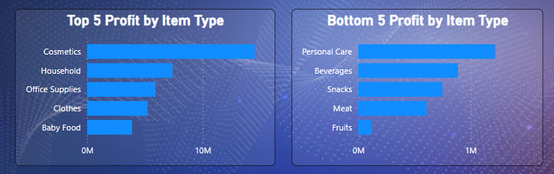
Top And Bottom Profit By Item Type:
The charts reveal a significant disparity in profitability across different item types. Cosmetics lead by a substantial margin in terms of profit, whereas fruits are the least profitable. This analysis suggests that focusing on high-profit categories like cosmetics and household items could be beneficial for maximizing overall profitability, while strategies to improve the profitability of lower-performing categories may also be considered.

Slide 6
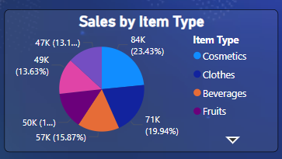
Sales By Item Type:
Cosmetics are the top-selling item type, making up almost a quarter of the sales, while Clothes and Beverages follow as significant categories. Fruits and other segments have a similar but lesser impact on the total sales, each contributing slightly over 13%.

Slide 7
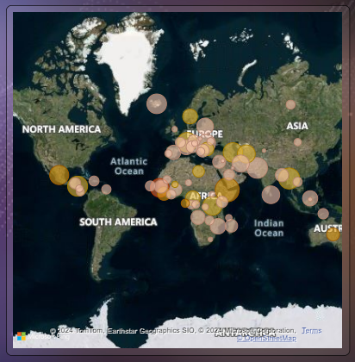
Geographical Sales Distribution:
The map visualization reveals that sales are widely distributed globally, with significant Amazon sales hubs in Europe and Africa. North America and Asia also show notable sales activity, while South America and Australia have comparatively fewer sales markers. This geographical distribution of sales can inform regional marketing strategies and resource allocation to maximize growth opportunities in high-concentration areas.

Slide 8
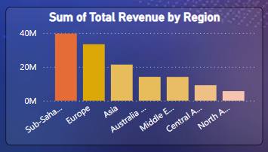
Region By Revenue:
It can be concluded that Europe and Sub-Sahara are the leading regions in terms of revenue generation for Amazon. The lower revenue figures in North America, Central Asia, and the Middle East could indicate underdeveloped markets or areas with potential for growth.

Slide 9
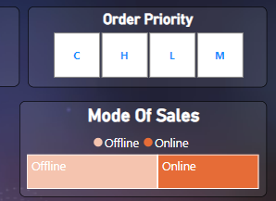
Mode Of Sales And Order Property:
Order Priority: This section is divided into four categories labeled 'C', 'H', 'L', and 'M'. These likely represent different priority levels for orders, such as Critical (C), High (H), Low (L), and Medium (M). This categorization can be used to analyze how Amazon prioritizes its order processing and delivery based on urgency or importance.
Mode of Sales: This section shows two modes of sales - 'Offline' and 'Online', with a visual emphasis on 'Online'. This indicates that Amazon's sales are predominantly online, which aligns with its business model as an e-commerce giant. The presence of an 'Offline' category, however, suggests that there might be some component of sales occurring through physical or non-internet-based channels, which could be interesting for a more detailed analysis.

Slide 10
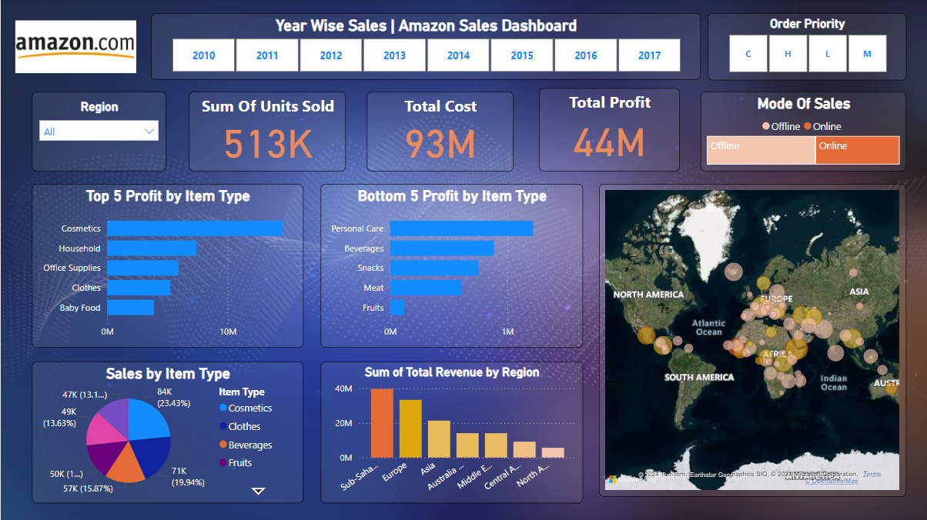
Dashboard

Slide 11

Conclusion:
In conclusion, the data provides valuable insights into Amazon's sales performance over the years. The analysis highlights the importance of online sales, regional revenue distribution, and profitable product categories. These insights can inform strategic decisions and future business plans.

